Slide 1
PYTHON WITH CONCURRENCY
Different types of concurrency
Concurrency with Python libraries:
threading
asyncio
multiprocessing
When to use concurrency

Slide 2
CONCURRENCY
Concurrency, or parallelism, is doing multiple computation tasks at a time
Computing workloads are often I/O bound
Waiting on disk or network
Take advantage of this and work on something else
Modern computers have multiple processors
Notes:
what is concurrency?
It’s the simple act of doing multiple things at the same time inside of your computer.

Slide 3
PYTHON
Python provides three standard libraries for concurrency:
threading
asyncio
multiprocessing
Global Interpreter Lock (GIL)
Notes:
Python provides three different mechanisms in the standard library for concurrency:
threading,
asyncio, and
multiprocessing.
Threading and async I/O are two different mechanisms for handling I/O-bound computing.
Multiprocessing is actually how to use multiple processors.
Solving I/O-bound computing problems, you use the first two.
Solving multiprocessor problems, you use the third one.
One thing to be aware of when dealing with concurrency in Python is the GIL, or the Global Interpreter Lock. For now, just understand that this is a locking mechanism that makes sure only one thing is happening at a time inside of the Python interpreter.

Slide 4
NEXT UP...
Latency in processing

Slide 5

TABLE OF CONTENTS
Overview
Computers and Latency
Concurrency
Threads in Python
Race Conditions
asyncio
Multi-processing
CPU Bound Workloads
Summary

Slide 6
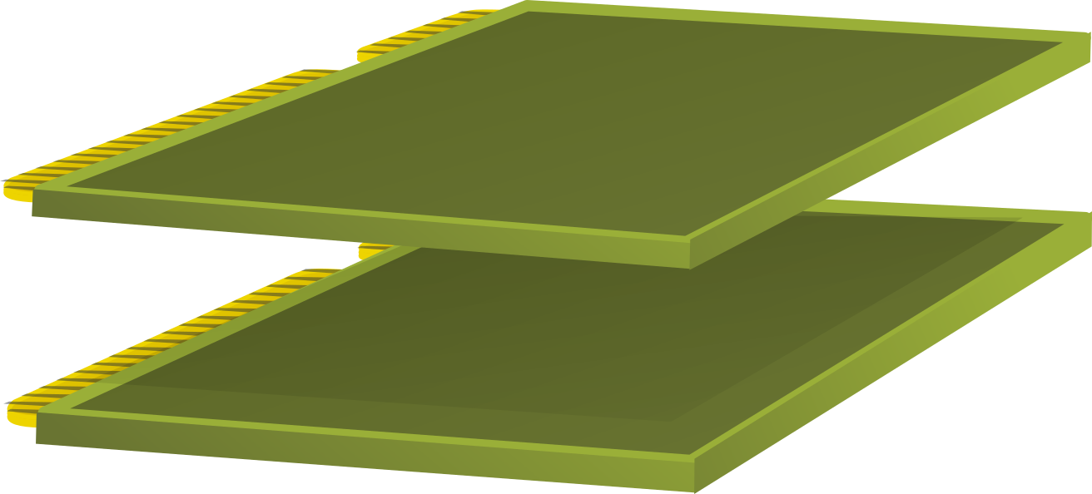





PARTS OF A COMPUTER
Peripherals
Storage
Memory
CPU
Images remixed from Gustavb
Notes:
Consider the basic parts of a computer.
This is where the actual computation happens.
Memory stores what is being worked on, and the CPU works with memory frequently.
Memory is generally volatile and is gone once you turn the computer off, so for longer-term storage, there’s usually a device like a hard drive.
there is some set of peripherals. Peripherals are usually used for input and output. This includes things like network cards, video cards, and external devices like keyboards and mice.

Slide 7





PARTS OF A COMPUTER
Peripherals
Storage
Memory
CPU
Images remixed from Gustavb
Notes:
In order for a program to run, the CPU must first fetch it from storage. The CPU sends an instruction down to the hard drive, asks for some data, and gets it back.
That information is pulled into the CPU. The CPU then sends that off to memory. In modern computers, there are ways of skipping the CPU to do this, which speeds things up, but for the purposes of this conversation, I’m going to keep things simple.
Once the program’s been loaded in memory, the CPU needs to get the next instruction from the memory and run that instruction inside of the CPU. That instruction often impacts peripherals—for example, sending something out onto the network.
The CPU sends information down to the peripheral card, and then the peripheral card itself sends information to the outside world. Each one of these components runs at different speeds, and this is where latency comes into effect.

Slide 8
LATENCY
1 ns = 1/1,000,000,000 s
Intel i7 => 100 instructions
Notes:
Consider the lowly nanosecond. That’s one one billionth of a second. To give you a sense of pace, a Intel i7 can run about 100 instructions in 1 nanosecond.

Slide 9
LATENCY
100 ns
Main memory reference
Notes:
Now multiply that out by 100. That’s about how long it takes to talk to main memory. So every time the CPU needs to talk to the memory, you need to delay by about 100 nanoseconds. Again, modern computers have ways of speeding this up, like L2 caches, but for the purposes of what I’m talking about, let’s keep it simple.

Slide 10
LATENCY
1 µs = 1000ns
Read 500kB from memory
x10 =
Notes:
02:31 Taking those 100 nanoseconds and grouping together. 10 of them gives you a microsecond or 1,000 nanoseconds. That’s about how long it takes to read 500 kilobytes from memory—a short program.

Slide 11
LATENCY
1 ms = 1000 µs
2 ms =~ Disk seek
150 ms =~ Ping time USA to Europe
x10 =
Notes:
02:46 Multiplying that out by 100 and then by 10 again, gives you a millisecond. 1 millisecond is 1,000 microseconds. It takes about 2 milliseconds for a disk to seek.
02:57 So when you ask the hard drive to look for something, if the read head is not on that position right now, it takes about 2 milliseconds for the read head to be repositioned.
03:08 150 milliseconds is about the ping time from the East coast of the United States to Europe, so that’s a packet going out across the Atlantic and coming back.

Slide 12









LATENCY
0.01 ns
1 cpu instruction
1 metre (=~ 1 yard) Height of door knob
825 µs
Read 1MB from disk 82,500 km, ~ 51k miles 2x Earth Circumference
1 ns
100 cpu instruction
100 metre (=~ 100 yard)
1 football field
100 ns
1 memory reference
10km, 6 miles
1/4 of a Marathon
3 µs
Read 1MB from memory 300km, 186 miles
3x length Suez Canal
2 ms Disk seek
200k km, 125k miles
½ Distance to Moon
150 ms
Ping USA to Europe 15M km, ~10M miles 1/10 distance to sun
Notes:
There’s a huge difference in scale between the instruction level, memory level, disk level, and peripheral level in your computer. There can be a factor of a thousand or more between different steps in this stack. To try and put this in perspective, let’s think about this like a distance. Think about a single CPU instruction as a meter, or about a yard. For the purposes of this analogy, they’re about the same. To help you visualize, that’s about the height of a doorknob off the ground on a regular door.

Slide 13
LATENCY
If it took 1 second to perform 1 instruction
Referencing Memory | 2 hours 47 minutes | 10k instructions
Disk Seek | 6 years, 4 months | 200M instructions
Seek + Read 1MB | 8 years, 11 months | 285M instructions
Ping Europe | 475 years, 8 months | 15B instructions
Notes:
05:35 These differences are huge and hard to wrap your head around. Let me try it another way to see if I can just hit it home. Pretend that instead of an instruction taking fractions of a nanosecond, it took a full second. Reading that megabyte from RAM would take 2 hours and 47 minutes, or you can run 10,000 instructions in that time. That pesky disk seek? 6 years and 4 months, or 200 million instructions.
06:01 A seek and reading a megabyte? 8 years, 11 months—just shy of 9 years. 285 million instructions.
And that ping time to Europe? 475 years, 8 months—or 15 billion instructions.

Slide 14
HURRY UP AND WAIT
Program 1
Program 1
Program 1
Program 1
Access RAM
Access Disk
Access Network
Time
Notes:
06:30 The modern ones are about three or four times that. Unfortunately, for the distances in latency it’s easier from a physics standpoint to increase the speed of a CPU than it is to increase the speed of network traffic. As a result, computer processors are getting faster and faster at a higher degree than the network traffic is getting faster. As CPUs get better and better, the latency difference between performing an instruction and going out to the network is getting more extreme, not less.
07:02 This is why most programs are I/O-bound. If you write a program that first accesses RAM, hundreds of instructions could be run in the time that it’s waiting. If it needs to access disk, that can be tens of thousands or millions of instructions before the program is ready to run again. And if you have to access the network, it’s billions of instructions.
07:23 This pattern is very common. In all likelihood, your program is I/O-bound. It spends more time waiting than it does computing.

Slide 15
NEXT UP...
Types of concurrency

Slide 16
TABLE OF CONTENTS
Overview
Computers and Latency
Concurrency
Threads in Python
Race Conditions
asyncio
Multi-processing
CPU Bound Workloads
Summary

Slide 17
TIME SLICING
Program 2
Program 2
Program 2
Program 3
Program 2
Program 3
Program 1
Program 1
Program 1
Program 1
Access RAM
Access Disk
Access Network
Time
Notes:
00:11 Recall this diagram from the previous lesson. It’s common for a program to have to wait long periods of time for it to be able to do the next instruction.
00:21 It needs to wait on RAM, disk, and network. Time slicing is the idea of the operating system mixing other programs into these wait states. While you’re waiting for that network packet to come back from Prague, the computer can insert multiple other programs to take advantage of that time.
00:40 This time slicing is how a single processor computer can look like it’s doing multiple things at the same time.

Slide 18
COOPERATIVE vs PRE-EMPTIVE MULTITASKING
No multitasking:
DOS operating system
Cooperative multitasking:
Program willing gives up CPU
Signals that it is going into a wait-state
Windows 3.1
Pre-emptive multitasking:
Program can be interrupted by the Operating System
Mainframes, Unix based, Windows NT/95 and forward
Notes:
00:48 Time slicing for multitasking can be thought of at three levels. The lowest level is not having any at all. The olden days of personal computers, the DOS operating system worked this way.
00:59 You could only run a single program at a time. Cooperative multitasking is when the program willingly gives up the CPU. If you know that you’re about to go out to the network and you’re not going to need the CPU for a while, you signal the operating system and the operating system can schedule a different program. In home computing, Windows 3.1 introduced this kind of multitasking.
01:21 If you happen to be old enough to remember using this operating system, you may recall that at certain times the program would just stop refreshing. That would be because it didn’t give up the CPU, but it was stuck in a wait state, so the UI was not being updated because the program had not told the operating system to put it into the wait state. As the name implies, cooperative multitasking requires all of the processes to cooperate with each other. In shared computing, or in the case of a program with a problem, this can be a challenge.
01:54 So preemptive multitasking was created. The operating system, in this case, interrupts the program whether or not it’s ready. The operating system is responsible for swapping between the different programs.
02:07 In most operating systems, this is done intelligently. If your program does do a network call, that triggers the operating system to take advantage of it and put the program into a wait state.
02:18 But it can also do it in the case where the program is being a hog and hasn’t given up the CPU.
02:24 Mainframes have done this from very early on, as has Unix. In the Windows world, NT and Windows 95 is where preemptive multitasking was first introduced.

Slide 19
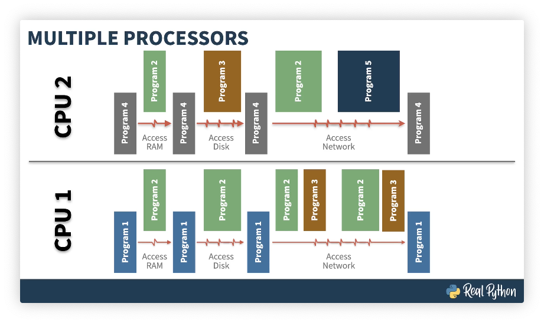
Notes:
02:36 On larger computers, you can have this time slicing as well as multiple processors. On each CPU, you can now have different programs running. In some cases, the same program may also be resident on those different CPUs.
02:51 In this diagram, programs 1, 4, and 5 are tied to a single CPU, but programs 2 and 3 are across the two CPUs. Part of the operating system’s responsibility is scheduling within the CPU and across the CPUs.

Slide 20
CONCURRENCY TYPES
Not all algorithms can take full advantage of concurrency
Trivial concurrency:
Comprised of activities that are independent of each other
No shared data
Example: a web server handling multiple clients at a time
Shared data concurrency:
Software typically has three steps: input, compute, output
Splitting up the compute portion means that co-ordination is required at the input and output stages
May require co-ordination amongst compute nodes
Notes:
03:09 Not all types of software can take advantage of concurrency equally. The type of concurrency you have can change what kinds of models you would use when creating a concurrent program.
03:20 Trivial concurrency is that where the different parts of the program can be split apart without concerns for each other. This can usually be achieved when activities within the program are completely independent of each other. This is easiest if there’s no shared data between the different components.
03:38 Consider a web server. You can have multiple clients talking to the web server at a time because each one of those clients don’t need to be able to talk to each other.
03:47 There may be some contention at the disk level, but as you saw in the lesson on latency, a huge amount of processing can be done while a server’s waiting for the disk.
03:56 In the non-trivial case, you have to share data across your concurrent components. When you’re thinking about this situation, it’s useful to think of three steps in processing: input, computing, and output.
04:09 Concurrency is generally done by splitting up the compute portion, but that may mean that there’s coordination necessary for the input and output stages. You may also need coordination amongst the different compute nodes, depending on what kind of algorithm you’re running.
04:25 Using the input, compute, and output model, you can think of programs in three parts. A producer is a component that produces data. This might mean reading something off the disk.

Slide 21
CONCURRENCY COMPONENTS
Concurrent programs can often be categorized into three parts:
Producer: component that produces data
Worker: computation component that does work
Consumer: component that consumes data
These concepts can be mixed and matched
Notes:
04:09 Concurrency is generally done by splitting up the compute portion, but that may mean that there’s coordination necessary for the input and output stages. You may also need coordination amongst the different compute nodes, depending on what kind of algorithm you’re running.
04:25 Using the input, compute, and output model, you can think of programs in three parts. A producer is a component that produces data. This might mean reading something off the disk.
04:37 The worker is the component that does the actual computation. And the consumer is the component that consumes the data or aggregates the output. Consider for a moment doing some image processing on a very large file.
04:52 The producer portion of your program would read the large image format, the worker portion of your program would do the actual filtering on the image, and the consumer component would consume the result from the worker and write the new image to the hard drive. Depending on the architecture of your program, these concepts might be mixed and matched. Using these three ideas, you can introduce different patterns in concurrency.

Slide 22
CONCURRENCY PATTERNS: PIPELINE
P
W
C
Notes:
05:19 This simple pattern has a producer pushing data to a worker, which pushes data to a consumer. It might not be immediately evident where you can get concurrency here, but because producers and consumers are interacting with the disk, a lot of work can be done in the worker while producers and consumers are working independently. Thinking back to the image processing example, the producer might read thousands of bytes off the disk, hand them off to the worker.
05:47 The worker could then manipulate those thousands of bytes, creating a result, which the consumer would then write to the disk. Unless the worker is particularly computationally intensive, in all likelihood it will most of the time be waiting for the producer and consumer.
06:03 But as soon as the worker has been fed data, it can start working. The producer does not have to have read the entire image off of the disk. This can produce some concurrency.

Slide 23




CONCURRENCY PATTERNS: N-WORKERS
W1
P
⋮
C
Wn
Notes:
06:15 A variation on this pattern uses multiple workers. Your producer reads information off of the disk, hands it off to a worker, which begins computation. The producer then reads more information off to the disk and hands it off to a second or third worker. The workers work independently, creating a result, and then the consumer is responsible for writing it back to disk.
06:37 This pattern is common with the processing of very large images. For the most part, an image can be broken up into components, and image processing can be done on those components independently.
06:49 This means the workers don’t have to talk to each other very often, giving a high degree of parallelism between the work they’re performing.

Slide 24


CONCURRENCY PATTERNS: BROADCAST
W1
P
⋮
C
Wn
Notes:
06:57 A variation on this pattern is for the producer to broadcast. In this case, each worker sees all of the data. It may not operate on all of the data, but as the data is exposed to it, it can continue to work.

Slide 25
CONCURRENCY PATTERNS: MIX-AND-MATCH
W1_{ɑ}
W1_{β}
P
⋮
C
Wn_{ɑ}
Wn_{β}
Notes:
These patterns can also be mixed and matched. You can have your producers broadcasting to workers, workers talking to other workers, and those workers consolidating information for the consumer.

Slide 26
CONCURRENCY CHALLENGES
Execution co-ordination: how to sync up different processes
Memory allocation: which processes get what memory
Scheduling: when are which processes active
Throughput: managing above concepts to work done per unit time
Distribution: threads, processes, machines
Deadlocks: two or more components waiting on each other
Resource Starvation: running out of memory, disk space, processes
Notes:
07:23 Programming concurrent systems introduces all sorts of new challenges to your software. Some things to consider. You must make sure that you’ve got execution coordination—different processes have to be able to sync up with each other.
07:36 Think of the image processing example. Let’s say your image was a megabyte large and split up into 10,000-kilobyte chunks. Each worker could work on one of those 10-kilobyte chunks, but in all likelihood, the borders between those 10-kilobyte chunks might impact the calculation in the chunk of image next door. So although for the most part the workers can work independently, when they reach the borders of the portions they’re working on, they may need to speak with other workers.
08:05 Once you have multiple processes operating, the operating system or the programmer themselves has to determine how memory is allocated across those multiple processes. This is hard enough in a regular program, it just becomes more complicated when dealing with concurrency. Scheduling is about when to determine which processes are active.
08:25 Thankfully, operating systems have done a lot of work on this. For the most part when you’re writing concurrent programs, you just let the operating system do the scheduling. But of course, that also means you’re giving up control, so there may be situations where this isn’t ideal.
08:40 Typically, the reason you’re writing a concurrent application in the first place is to be able to get things done faster. And really what you’re talking about here is higher throughput—more work done per unit time. How you manage execution coordination, memory allocation, and scheduling can change the throughput on your system, and you might need to fine-tune how these things behave in order to actually see speed-up. Somewhat related to scheduling is also distribution.
09:08 How do you split up at the different concurrent pieces amongst the CPUs on your machine or between machines? Writing concurrent software introduces algorithmic challenges.
09:19 Deadlocks are when two or more components are waiting on each other. If A is expecting B to do something, and B is waiting for A to do something, nothing is ever going to happen. And finally, resource starvation may also be a problem.
09:33 The different components of your program may be fighting for memory, disk space, or access to the CPU.

Slide 27
CONCURRENCY IN PYTHON
Operating system level
Multi-processor
Threads
asyncio
Notes:
09:41 Concurrency can be applied at different levels in Python. The simplest is at the operating system level. This means, as a programmer, you don’t have to really worry about it.
09:50 You can run Python in a window or in your IDE and let the operating system take care of the fact that other things are happening at the same time. If you have multiple processors available on your computer, you can use the multiprocessor library in Python to have code execute on those different processors.
10:09 Modern operating systems have a lighter-weight way of getting concurrency called threads. Each thread in a program can execute different code. Threads can then be scheduled to take advantage of the I/O-bound nature of your program.
10:22 In addition to having threads in the standard library, Python has another mechanism using coroutines called asyncio. The rest of this course describes the async I/O, thread, and multiprocessor standard libraries in Python and the differences between them

Slide 28
PYTHON GIL
Global Interpreter Lock
Mutex (thread lock) ensuring only one thread controls the interpreter at a time
Limits multi-threaded execution
In place to prevent race conditions with memory and reference allocation
Particularly important when Python interacts with C-extensions
Lots of discussions on what to do about the GIL
Guido: only remove GIL if new code does not decrease the performance of a single-threaded program
CPython and PyPy thing! Jython and IronPython do not use a GIL
Notes:
When considering concurrency inside of Python, you have to be aware of the GIL.
10:44 This is the Global Interpreter Lock. The GIL is a thread lock, or mutex, that makes sure that only one thread controls the interpreter at a time.
10:54 This limits the way multiple threads can operate inside of Python. When two concurrent parts of a program operate at the same time, you can get race conditions.
11:05 If you have this kind of race condition inside of memory allocation, you will get memory leaks. The GIL was introduced to solve this problem. One of the powers of Python is the ability to extend it using C. You can write code in C and plug it in underneath and then have it called by Python. Although this makes Python powerful, it also makes memory allocation challenging.
11:29 Now you have to deal with memory both at the interpreter level and at the C extension level. The GIL is particularly important when dealing with these kinds of interactions. If you do a quick Google on Python and GIL, you’ll find all sorts of opinions out there. It is seen by some as a limitation. Whatever you feel about it, it’s deeply nested inside of the interpreter, and removing it is not a simple thing.
11:54 The original inventor of Python, a gentlemen named Guido, has stated that the GIL should only be removed if new code does not decrease the performance of a single-threaded program.
12:05 This is one of the reasons it’s stuck around for such a long time. To be clear, the GIL is an implementation detail of the interpreter. CPython and PyPy both have it but Jython and IronPython do not use the GIL, so depending on your underlying interpreter, you may or may not run into this.

Slide 29
PEP 554
“Multiple Interpreters in the Stdlib”
https://www.python.org/dev/peps/pep-0554/
CPython supports subinterpreters
Subinterpreters are a feature at the C-extension level allowing for concurrency
Interpreters are independent of each other
PEP 554 proposes exposing these interpreters in the Python standard library
Does not fix the GIL
As changes around the GIL happen, they can be exposed to programmers earlier
Notes:
12:57 The interpreters are essentially independent of each other. PEP 554 proposes exposing these interpreters in the Python standard library. This doesn’t fix the GIL, but would give programmers access to more tools that allow them to work around the GIL. And as changes happen around the GIL, they could be exposed to the programmers earlier inside of these subinterpreters, hopefully improving the ability to do concurrency in Python.
13:25 Although the GIL is a challenge, the I/O-bound nature of most programs means that you can still do concurrency in Python. In the next lesson, I’ll introduce you to the threading library, a good way to do just that.

Slide 30
NEXT UP...
Python threading library

Slide 31
TABLE OF CONTENTS
Overview
Computers and Latency
Concurrency
Threads in Python
Race Conditions
asyncio
Multi-processing
CPU Bound Workloads
Summary

Slide 32
I/O BOUND CONCURRENT PROGRAM
Most programs spend a lot of time waiting for I/O
Threads allow you to time slice your computation, doing processing work while waiting
Threads work within the GIL
Significant speed-up can result for disk or network heavy software

Slide 33










N-WORKERS PATTERN
with concurrent.futures.ThreadPoolExeuctor(max_workers=5)
download_site()
executor.map()
download_site()
download_all_sites()
print("Downloaded")
download_site()
download_site()
download_site()

Slide 34
THREAD SAFETY
Memory is shared across threads
Consider two threads using a single requests.Session() object
Thread 1 starts downloading from Jython, gets interrupted
Thread 2 tries to start downloading from RealPython, but the session object wasn’t done
Low-level primitives fix this using a mechanism called locking
Higher level primitive: threading.local()
Looks like a global variable, but is actually created per thread
get_session() created a new requests.Session() object per thread

Slide 35
MORE THREADS FOR THE WIN?
Thread pool size set to 5 even though downloading 160 URLs
There is overhead creating threads
There is overhead switching between threads
Too many threads means code spends all its time managing threads

Slide 36
WHAT ABOUT?
Basic thread primitives:
Thread.start() Thread.join() Queue
The concurrent.futures library and Executors abstracts these away
Introduced in Python 3.2

Slide 37
NEXT UP...
Race conditions

Slide 38
TABLE OF CONTENTS
Overview
Computers and Latency
Concurrency
Threads in Python
Race Conditions
asyncio
Multi-processing
CPU Bound Workloads
Summary

Slide 39
CONCURRENCY IS HARD
Shared memory and objects can be problematic
Locks and threading.local() help, but you must remember to use them
Most things aren’t thread safe!
requests.Session()
print()
Better to assume not thread safe

Slide 40
NEXT UP...
Python asyncio library

Slide 41
TABLE OF CONTENTS
Overview
Computers and Latency
Concurrency
Threads in Python
Race Conditions
asyncio
Multi-processing
CPU Bound Workloads
Summary

Slide 42
EVENT LOOPS
asyncio was introduced in Python 3.4
Independent of the operating system
Event loop and coroutines
Concurrency is achieved co-operatively with your tasks giving up their turns
Keywords:
●
●
async await

Slide 43
LIBRARIES
asyncio still fairly new
Libraries are just starting to take advantage of it
Instead of requests, need aiohttp
$ python -m pip install aiohttp
...
Installing collected packages: multidict, async-timeout, yarl, aiohttp
Successfully installed aiohttp-3.6.2 async-timeout-3.0.1 multidict-4.7.6 yarl-1.5.1

Slide 44
ERROR HANDLING
await asyncio.gather(*tasks, return_exceptions=True)
return_exceptions dictates what to do if something goes wrong
Either:
Cause a normal exception (default)
Register the exception in the task object
Tasks can be introspected
Task.result() will return result of a coroutine or raise:
Exception caused by task
●
●
CancelledError InvalidStateError

Slide 45
THREADS vs aysncio
asyncio concurrency requires less overhead, tends to out-perform threads
Coding with asyncio is slightly more complicated
asyncio is still new
Co-operative vs pre-emptive multitasking

Slide 46
NEXT UP...
Multiple processes

Slide 47
TABLE OF CONTENTS
Overview
Computers and Latency
Concurrency
Threads in Python
Race Conditions
asyncio
Multi-processing
CPU Bound Workloads
Summary

Slide 48
MULTIPROCESSING
Everything so far has been on a single CPU
The multiprocessing library gives the ability to run on multiple CPUs
Each CPU gets its own instance of the interpreter

Slide 49
MULTIPROCESSING
with multiprocessing.Pool(initializer=set_global_session) as pool: pool.map(download_site, sites)
By default Pool gives you one process per CPU in your computer
Each process has its own memory space, initializer is run per process within its local memory
The multiprocessing library gives the ability to run on multiple CPUs
Each CPU gets its own instance of the interpreter

Slide 50
MULTIPROCESSING vs THREADING
Lots of overhead in creating a process
Operating System specific differences
Tends to require more memory
Tends to be slower to initialize
Sharing information between processes must be done using explicit constructs:
Queue and Pipe
Shared memory: Value & Array
Usually used to map processes to CPUs

Slide 51
NEXT UP...
CPU Bound computation

Slide 52
TABLE OF CONTENTS
Overview
Computers and Latency
Concurrency
Threads in Python
Race Conditions
asyncio
Multi-processing
CPU Bound Workloads
Summary

Slide 53
I/O BOUND vs CPU BOUND WORKLOADS
I/O Bound: waiting on input and output
CPU Bound: waiting on computation
Threading and asyncio only see speed-up in I/O bound cases
CPU bound requires multiple CPUs

Slide 54
WHEN TO USE CONCURRENCY
Premature optimization is the root of all evil (or at least most of it) in programming.
-- Donald Knuth
Concurrency introduces extra complications:
More code
Types of concurrency
Thread-safety and memory sharing
Ask yourself: do you really need it?
Decide on a model
Favor asyncio over threads if you can

Slide 55
NEXT UP...
Summary

Slide 56
TABLE OF CONTENTS
Overview
Computers and Latency
Concurrency
Threads in Python
Race Conditions
asyncio
Multi-processing
CPU Bound Workloads
Summary

Slide 57
SUMMARY
I/O bound vs CPU bound computing
Latency in I/O bound computing
Concurrency patterns
Pipes
N-Workers
Broadcast

Slide 58
CONCURRENCY IN PYTHON
Python includes in the standard library:
●
●
●
threading asyncio multiprocessing

Slide 59
CHOOSING CURRENCY
Are you sure you need it?
Is it I/O bound?
Prefer asyncio over threading
Careful with thread safety and shared memory

Slide 60
FURTHER READING
Latency:
https://colin-scott.github.io/personal_website/research/ interactive_latency.html
http://norvig.com/21-days.html
Concurrency:
https://en.wikipedia.org/wiki/Concurrency_(computer_science)
Python GIL:
https://realpython.com/python-gil/
https://wiki.python.org/moin/GlobalInterpreterLock
Subinterpreters
●
●
https://www.python.org/dev/peps/pep-0554/ https://medium.com/@carreira.mktp/python-3-9- subinterpreters-and-c-extension-wars-f140f1460fd5

Slide 61
FURTHER READING
Old school threading:
https://docs.python.org/3/library/threading.html
https://realpython.com/intro-to-python-threading/
Threads and Futures:
https://docs.python.org/3/library/concurrent.futures.html
asyncio:
●
●
https://realpython.com/async-io-python/ https://stackoverflow.com/questions/49005651/how-does- asyncio-actually-work/51116910#51116910
Multi-processing:
●
●
https://docs.python.org/3/library/multiprocessing.html http://zetcode.com/python/multiprocessing/

